Slide 1

LaunchCode Liftoff
Class 4
Hank DeDona
8/23/2021

Slide 2
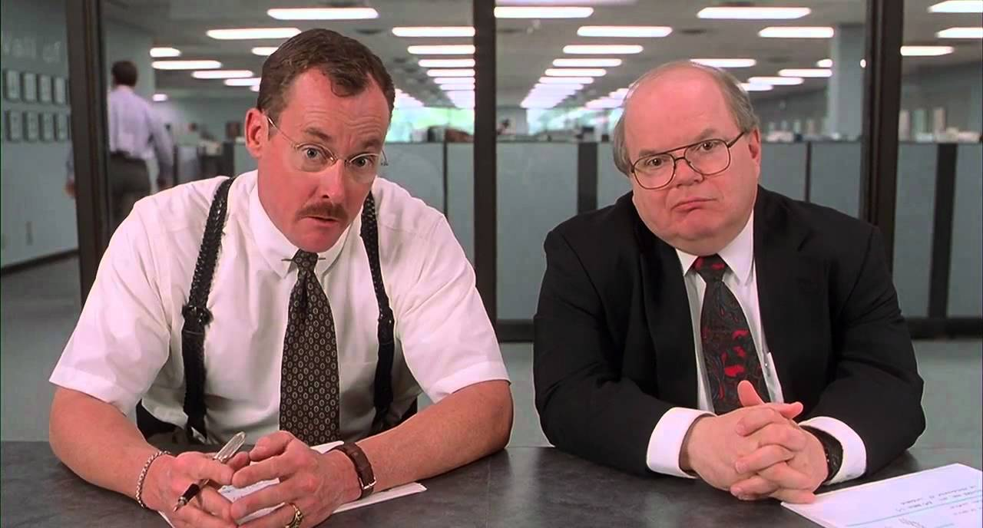
Objectives
Know what an interviewer is looking for from a live coding session
Explain the steps necessary for a successful live coding session
Know where to find prompts for live coding practice
Know how to give and receive good code review feedback

Slide 3
Liftoff Project Timeline
Capstone Project Selected
Wireframes & Initial Features
Class 1
Class 3
Class 2
Class 4
Wireframes & User Stories
Project Review 1

Slide 4
Liftoff Project Timeline
Address Feedback
Live Coding Interview
Next Features
Behavioral Interview
Class 5
Class 7
Class 6
Class 8
Next Features
Final Review
Notes:
Resume Aug 21st

Slide 5
Personal Branding
Notes:
Advocate for personal branding
Build networks, know what’s hot, get new jobs, never settle

Slide 6
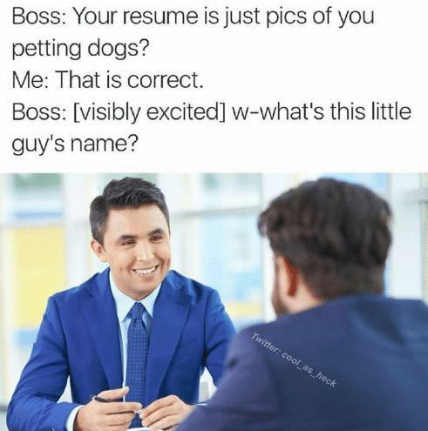
Technical Resumes
Have an Objective
List Technical Skills
Highlight Your Strengths
Use Action Words & Concrete Results
Tailor Your Resume
KISS (Keep It Simple, Stupid)
List LaunchCode LC101 & Liftoff
Notes:
Prep Work Example https://education.launchcode.org/liftoff/articles/technical-resume/
My Resume: https://drive.google.com/file/d/0Bx04Qd46sWDgdjVZOWlFUUd1QmM/view?usp=sharing

Slide 7
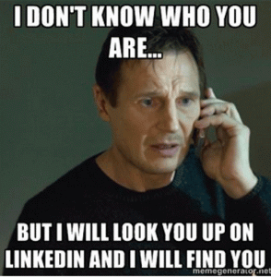
LinkedIn
Summary - Tell a Story!
Projects - Highlight Features
Education - LaunchCode \o/
Skills
Volunteering
Accomplishments

Slide 8

GitHub Profile
Professional Name and Picture
Star Your Best Projects

Slide 9
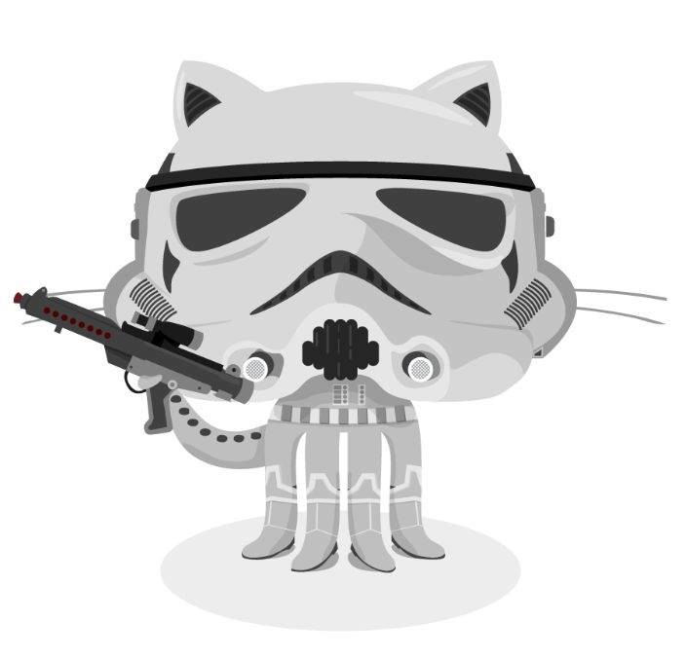
GitHub Projects
Clear Names
Self-Contained
Clean Up Cruft
Common Files to Include:
README.md
Create a README
Mastering GitHub Markdown
License.txt
.gitignore

Slide 10
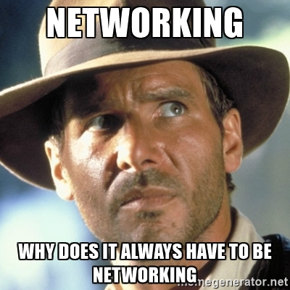
Online Communities
LaunchCode Community & Alumni
Meetup: https://www.meetup.com/
Twitter
Hacker News: https://news.ycombinator.com/
Reddit
Menteaship www.menteaship.com
Share Your Favorites in #general
Notes:
How do I keep up (know what to know)?
Networking!? Business cards!
Make connections, ask questions, find what excites you, it’s a big world

Slide 11
Code Reviews

Slide 12
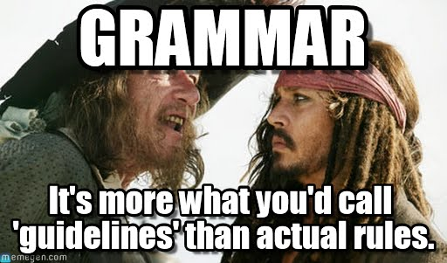
Clean Code Best Practices
Remove Dead Code
Clear Method & Variable Names
Encapsulate Duplicated Logic (DRY)
Comments Explain Why Not How
Clear Commit Messages
Spacing and formatting helps
Note: Teams will usually have predefined formatting/spacing/naming

Slide 13
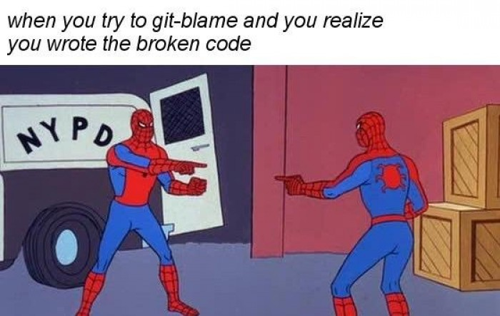
Some Lessons You Have To Learn The Hard Way

Slide 14
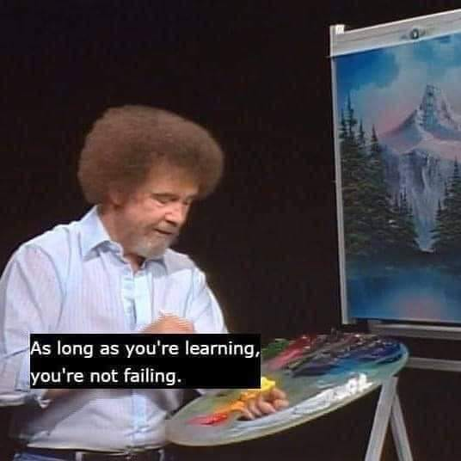
Addressing Feedback
Prioritize Changes (critical functional bugs first)
A Code Review Is About The Code, Not You
Don’t take it personally!
Ask What Could Be Improved
Ask For Clarification and Explanation
Pair Up (pair programming)

Slide 15
Giving Feedback
We’re All Learning
Ask For Clarification
Avoid “you” statements
Provide Actionable Suggestions

Slide 16
Recap and Q&A
Tonight’s Objectives:
Know what an interviewer is looking for from a live coding session
Explain the steps necessary for a successful live coding session
Know where to find prompts for live coding practice
Know how to give and receive good code review feedback

